Slide 1
Leave & Timecards & Admin

Slide 2
Agenda
Compensation & benefits
Leave &Time Cards
Admin
C&B Policy

Slide 3
Accrual yearly
1st year: 7 days
2nd year: 12 days
3rd year and above year :15 days
Accrual monthly
1st year: 7days/12months=0.5833day/month
2nd year: 12days/12months=1day/month
3rd and above year: 15days/12months=1.25days/month
HR calculate and track vacation monthly, vacation balance list in monthly pay slip

Slide 4
Leave
Sick leave
12 days paid sick time which is granted at the
beginning of the Calendar year
If the actual working days are not greater
than 10 business days（include holiday）in a month, the
paid sick time will not be accrued for that month
cannot be transferred to next year
Unpaid leave
Interns/employee during probation period/after submit terminate request
Bereavement leave
3 calendar day’s for Employee’s immediate family
1 calendar day’s leave for Employee’s collateral family

Slide 5
Leave
Examination Leave
A half-day’s paid leave for examination which is related
to career advancement with the Company
Marriage\Maternity\Nursing\Work-Related Injury leave
Will be entitled according to applicable regulation
More details can be found in Employment Handbook/HR Q&A/人事福利指南

Slide 6
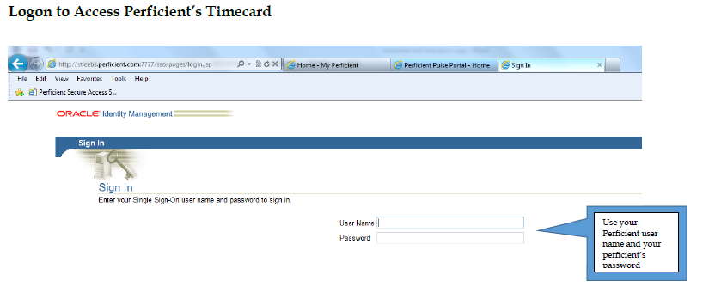
Ask for Leave
How to ask leave :
Any leave should submit a leave request in ‘My Absence Management’ in EBS and get the approval from approver(GDC PM and GDC HR ).
Oracle EBS can be found here:
https://ebs.perficient.com

Slide 7
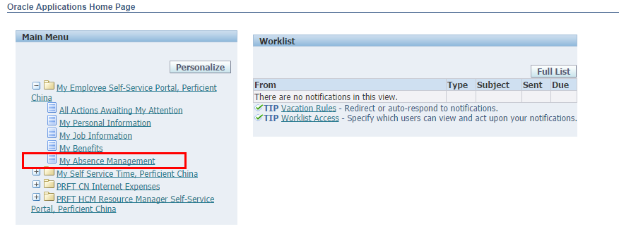
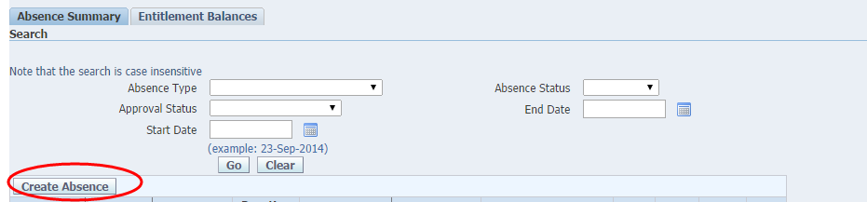
Ask for Leave
Step 1：
Step 2：

Slide 8
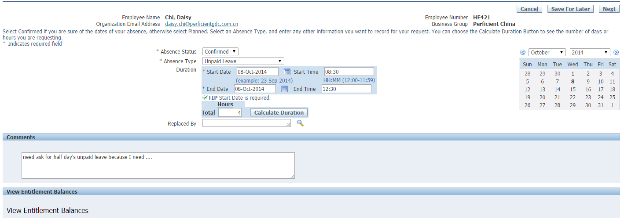
Ask for Leave
Step 3：
Select ‘Confirmed’ status
If you are asking for whole day leave, no need to enter start and end time
Click here/ the system can calculate the duration
Enter comments to tell your approval leave reason
The approver has automatically sent up in the system

Slide 9
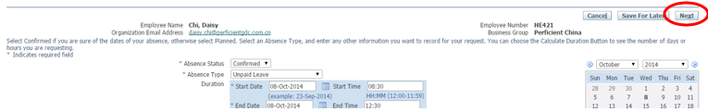
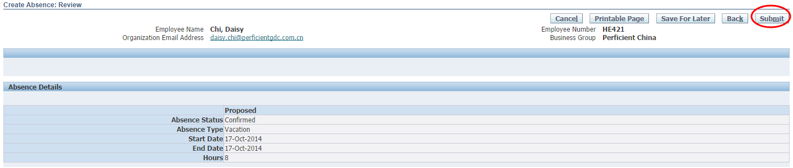
Ask for Leave
Step 4：
Then click ‘Next’
Step 5：
Review and click ‘Submit’
Step 6：
Waiting for the approver to approve your absence request. After you got approval, then you can enter leave data into your timecards.

Slide 10
Timecard Rules
It is very important to fill your time card correctly and submit on schedule
Time record
Fill the actual working hour for everyday. Not less than 40 hours per week in total.
Time Distribution
If time is spent on different projects, please choose different projects and fill in relevant time.
Time submit
Time should be submitted in time on every Friday or Monday
Exception: When the end of the month falls during the work week, please submit that time card on the last day of the month and you must complete the time card for any days remaining in the week at the end of the week.
Each colleague is responsible for entering their time in a timely manner. On time entry is a critical component for effectively running our business. To emphasize the importance and reinforce individual accountability, any colleagues that have more than 2 weeks during a semester with late time entry will have their consulting colleague bonus earned for that semester reduced by 10%. There will be no exceptions to this penalty.
Time assignment
Employee will be assigned to an internal project and one or more client projects
If you are not assigned to a project, you cannot enter time or expenses against that project.

Slide 11
Fill timecard
How to fill timecards:
Any leave should submit a leave request in ‘My Absence Management’ in EBS and get the approval from approver(GDC PM and GDC HR ).
Oracle EBS can be found here:
https://ebs.perficient.com

Slide 12
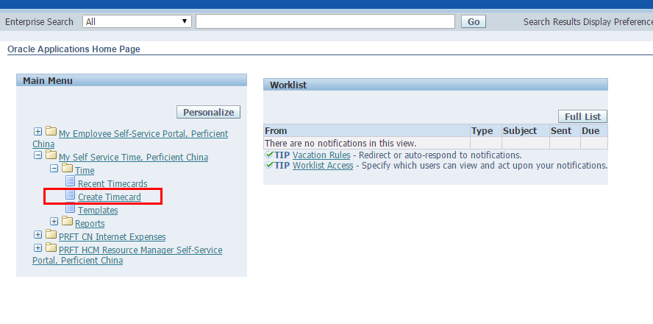
Fill timecard
Step 1：

Slide 13
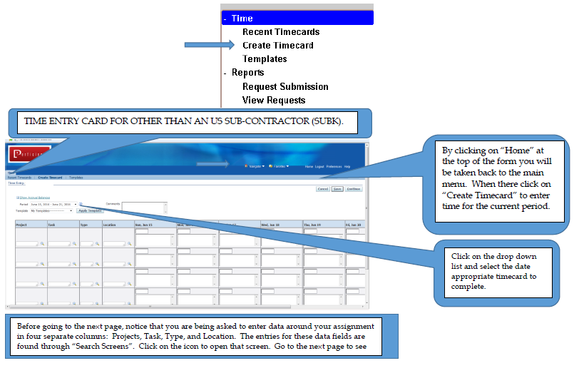
Fill timecard
Step 2：

Slide 14
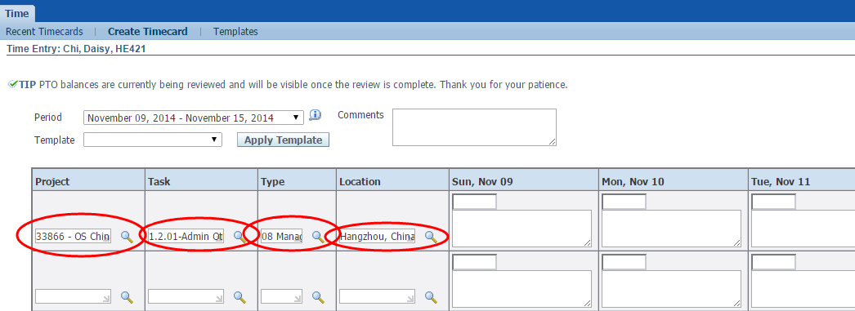
Fill timecard
Step 3：
Enter in the Project / Task / Type / Location, the search way can be found in the next page
Go to SharePoint to download Project/Task/Type/Location general rules:
Sharepoint > GDC > HR > Time card

Slide 15
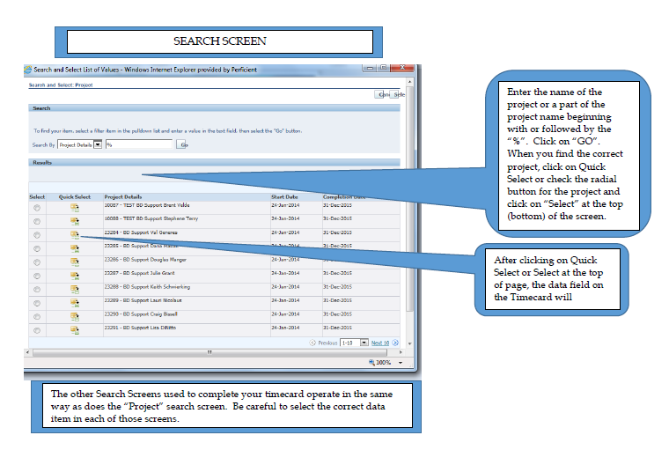
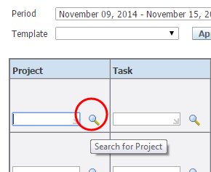
Fill timecard

Slide 16
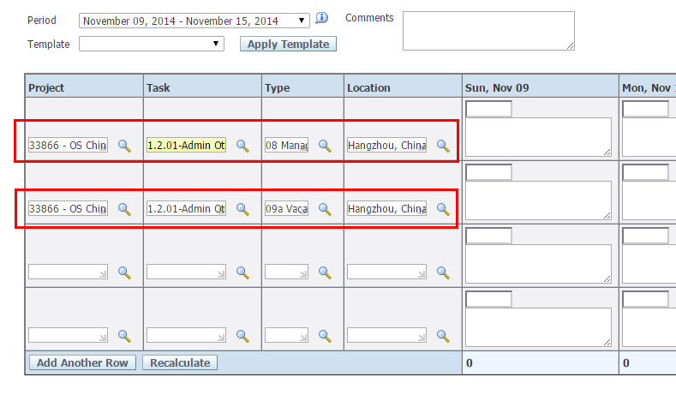
Fill timecard
If we have worked under different conditions on that week, we will express in a second row of the timecard.

Slide 17
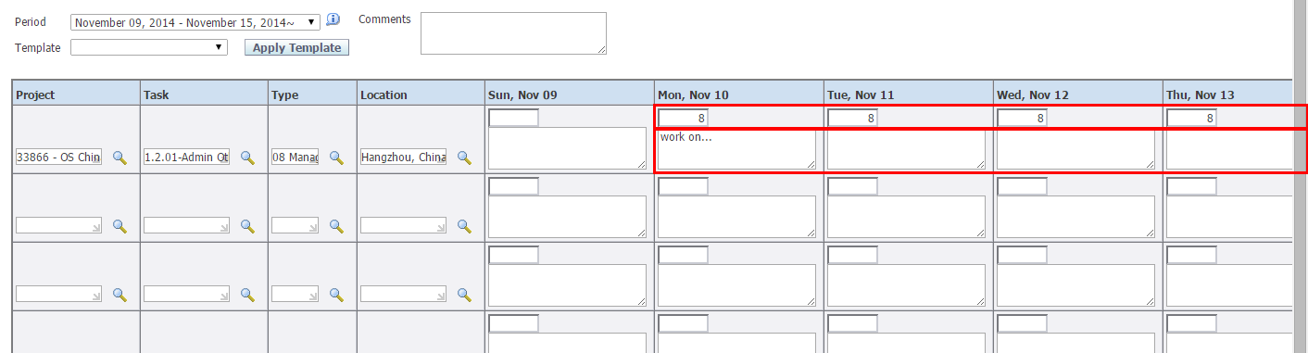
Fill timecard
Step 4：
After entering your work parameters in the first 4 columns, enter your time.
Do not enter less than half hour increments
Paid Time off (Vacation, Sick) should be entered in 4-hour increments
After entering your work parameters in the first 4 columns, enter your time.

Slide 18
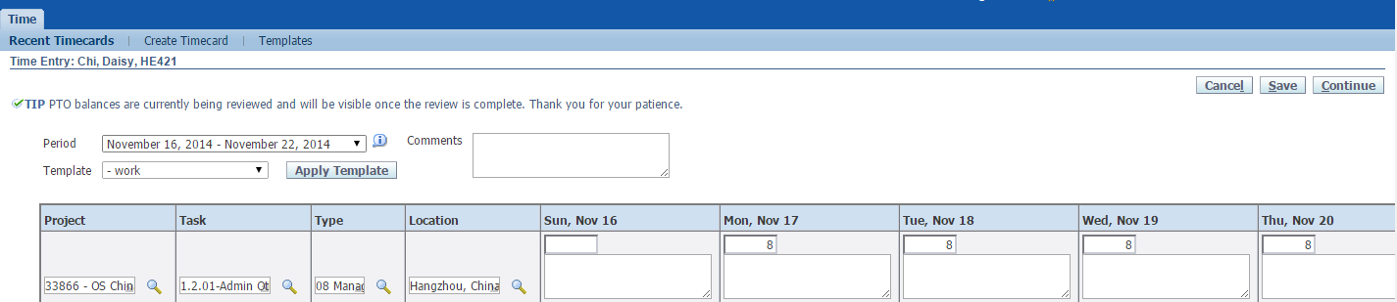
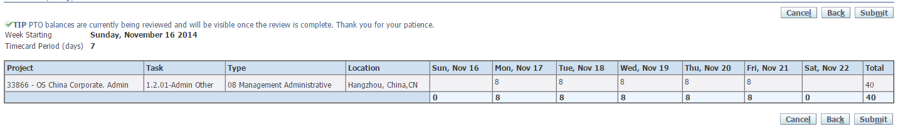
Fill timecard
Step 5：
If you are not sure of the time data, you can select ‘save’to save the record first and edit it later
after bringing up the timecard you want to update, make the changes and then click on 'Continue'
Step 6：
After clicking on'Continue',this review screen will open. When you are ready to submit your timecard for approval, click on 'Submit'

Slide 19
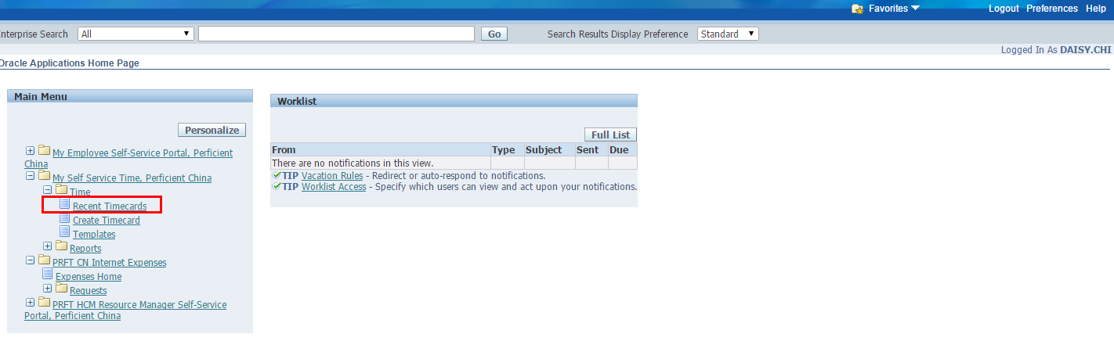
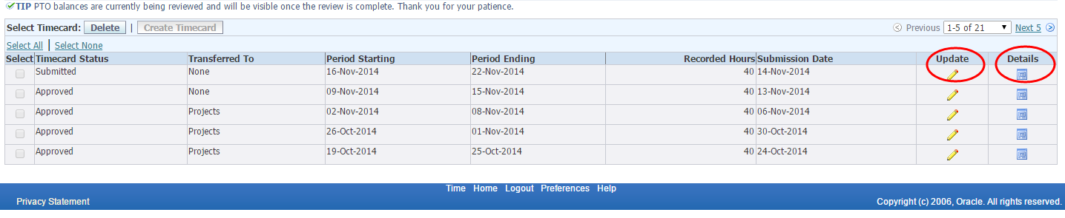
Fill timecard
Review and edit recent timecards：
Using the same report showing recent timecards,click on'Details' on one of the lines to learn more about the hours and days worked during a previous time period
click one‘Update' , you can update your timecard no matter the status is ‘Submitted ’or ‘Approved’

Slide 20
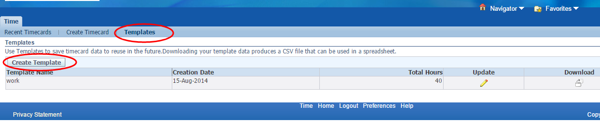
Fill timecard
Creating timecard templates：
You can create a template to simplify and improve accuracy of time entry. You can enter the parameters of your work wee such as Project , Task, Type, and Location. You can also enter hours that are consistently the same.

Slide 21
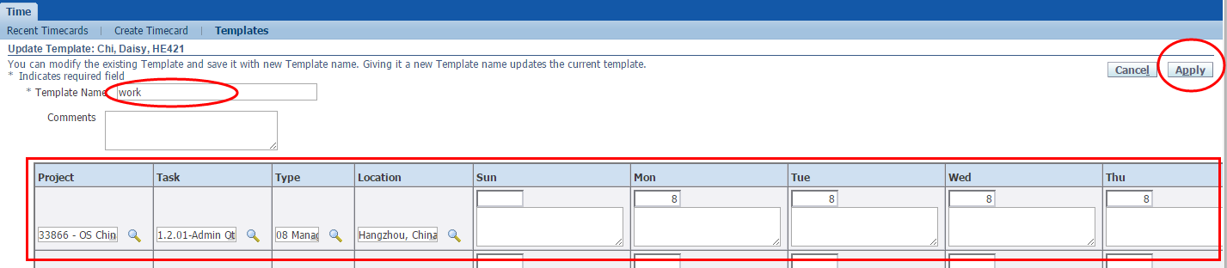
Fill timecard
Enter a name,for example naming it after a project that you are consistently working on

Slide 22
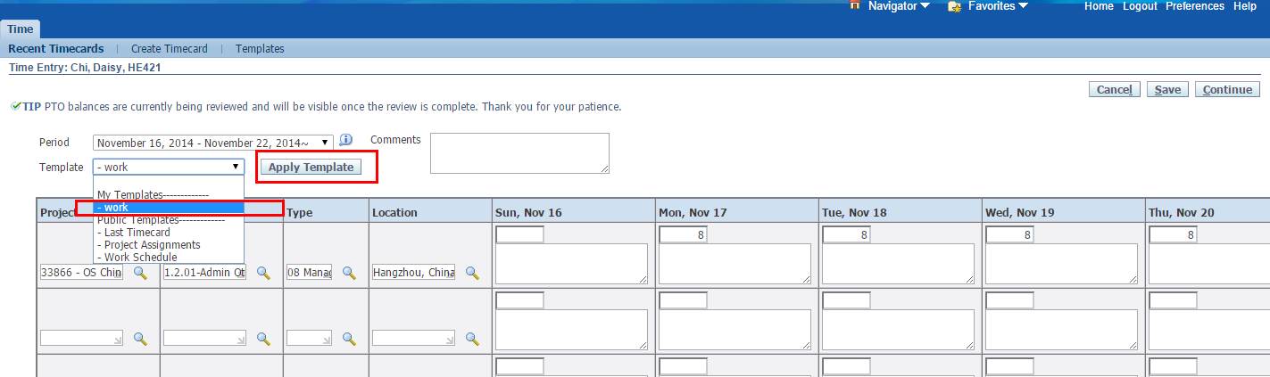
Fill timecard
The next time you go in to enter time onto your timecard you could elect to use one of your templates by showing the available Private Templates. In the last screen, we created one called 'Work' which you use if appropriate.

Slide 23
Departmental policy and procedure – Admin

Slide 24
Facility
Stationery
You will get a set of stationeries from admin when on board.
You can find stationeries in cabinets near the printers when need.
Air conditioner
Please make sure you open the AC under a proper indoor temperature.
please send out email to everyone to remind closing windows when open the AC.
Please turn off AC when you finish a meeting and leave the meeting room.
Please turn off all ACs if you are the last people to leave office.
Kitchen equipment
Keep refrigerator cleaning, throw out overdue or bad foods for health
Use coffee machine by following the operation manual

Slide 25
Service
Personal information
If your personal information changes (such as bankcard number, cell phone number, address…), please send updates to OS CHN HR for change in case it impact your salary of benefit
Express/Package
Employees take own express and package by self.
If you want to send individual express/Package, please contact the express company directly(the contact information is available on the wall)
Office facility issues report
Please send email to OS CHN Facility when you found office facility issues or you can find admin person directly

Slide 26
Thank You !

